Slide 1
TIMETABLE GENERATOR
GUIDED BY DONE BY
DR S.ANNIE JOICE BALA MURALI KRISHNA D(830120104003)
GOKULAKRISHNAN M(830120104007)
VIMAL RAJ A(830120104034)

Slide 2
ABSTRACT
The Timetable Generation Process for Educational Institutions is a complex task that involves scheduling multiple classes for a large number of students and staff. The goal is to create a balanced and efficient schedule that meets the needs of all stakeholders. To achieve this, various constraints such as teacher availability and student schedules need to be taken into account. Genetic Algorithm have been developed to automate the timetable generation process, allowing institutions to generate schedules efficiently and accurately. The use of these algorithms can save a significant amount of time and effort compared to manual timetable generation and minimize the risk of errors and conflicts. By implementing an Automated Timetable Generation System, Educational Institutions can improve their resource utilization, enhance the learning experience for students, and increase overall efficiency

Slide 3
INTRODUCTION
A Timetable Generator is a software application designed to automate the process of creating schedules for educational institutions.
The generation of a comprehensive and accurate timetable can be a complex and time-consuming task, especially when done manually. This is where a Timetable Generator comes in as a solution to streamline the scheduling process and make it more efficient.
With the ability to input information about classes, teachers, and students, the Timetable Generator can generate a customized timetable that takes into account availability, conflicts, and other requirements.
The Timetable Generator software is a valuable tool for any educational institution looking to improve the efficiency and accuracy of its scheduling process.

Slide 4
PROBLEM STATEMENT
Educational institutions, such as schools and colleges, face the challenging task of creating and managing schedules for classes, teachers, and students. This process can be consuming and prone to errors when done manually. Existing scheduling software solutions often lack the flexibility and customization required to meet the specific needs of different institutions.
The need for an efficient, accurate, and customizable Timetable Generator software is evident, one that can automate the scheduling process, reduce manual effort, and improve accuracy. The software should also be user-friendly and accessible through a software interface, and be able to resolve scheduling conflicts, generate reports, and provide data analysis to support informed decision-making.

Slide 5
LITERATURE REVIEW
The existing system formulated a class or teacher timetabling problem by considering that each lecture contained one group of students, one teacher, and any number of times which could be chosen freely.
Since then the problem is being continuously studied using different conditions. Initially it was mostly applied to schools. Since the problem in schools are relatively simple because of their simple class structures, classical methods, such as linear or integer programming approaches could be used easily.
However, the gradual consideration of the cases of higher secondary schools and universities, which contain different types of complicated class-structures, is increasing the complexity of the problem.

Slide 6
EXISTING SYSTEM
MS

Slide 7
DISADVANTAGES OF EXISTING SOFTWARE
Difficulty in data management
Compatibility issues
Error-prone

Slide 8
PROPOSED SOLUTION
By using the Flutter framework of Dart language, it overcomes the Compatibility issues as it allows cross platform development.
Microsoft Excel is a spreadsheet program and not a database management system. As a result, it may be prone to errors, But here we use mongo dB for database management system.
It is difficult to generate the time table without clash in MS Excel whereas while using Dart language and Genetic algorithm the time table can be generated more efficiently compared to MS Excel.

Slide 9
TECHNOLOGY STACK
Dart – Programming language
Flutter – Dart Frontend Framework
Mongo dB – Database Management System
Android Studio – For Android Emulator
Visual Studio Code - IDE

Slide 10
FEATURES
Data storage
Conflict detection
Class schedule visualization
Mobile compatibility

Slide 11
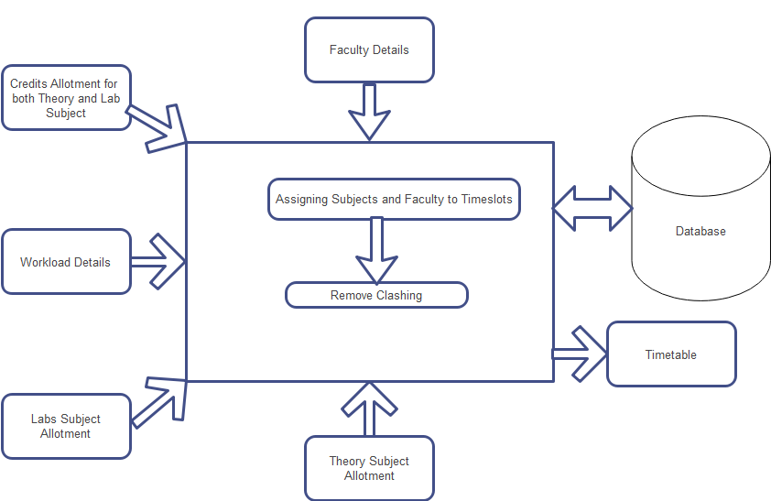
SYSTEM ARCHITECTURE

Slide 12
MODULES
Fitness Function Module
Initial Population Generation Module
Selection Module
Crossover Module
Mutation Module
Termination Module
Output Module

Slide 13
CONCLUSION
Effective time table generation requires careful planning and attention to detail. It is essential to consider the availability of classrooms, instructors, and students, and allocate them in a way that minimizes conflicts and maximizes productivity. The use of computer algorithms and scheduling software can significantly simplify the time table generation process and help ensure that the final schedule is efficient and feasible.
In conclusion, the generation of a time table is a complex process that requires careful consideration of multiple factors. By using the right tools and techniques, it is possible to create a well-structured schedule that meets the needs of all parties involved and contributes to a more organized and efficient workflow.

Slide 14
REFERENCES
Chowdhary A, Kande P, Dhone S, Ingle S, Rushiya R, And Gawande D, 2014 Timetable Generation system. International Journal of Computer Science and Mobile Computing, 3(2).
Bhaduri, A., 2009, October. University timetable scheduling using genetic artificial immune network. In Advances in Recent Technologies in Communication and Computing, 2009. ARTCom'09. International Conference on (pp. 289Y292). IEEE.
International Journal of Engineering Research & Technology (IJERT) http://www.ijert.org ISSN: 2278-0181 IJERTV9IS070568 Published by : www.ijert.org Vol. 9 Issue 07, July-2020

